Slide 1
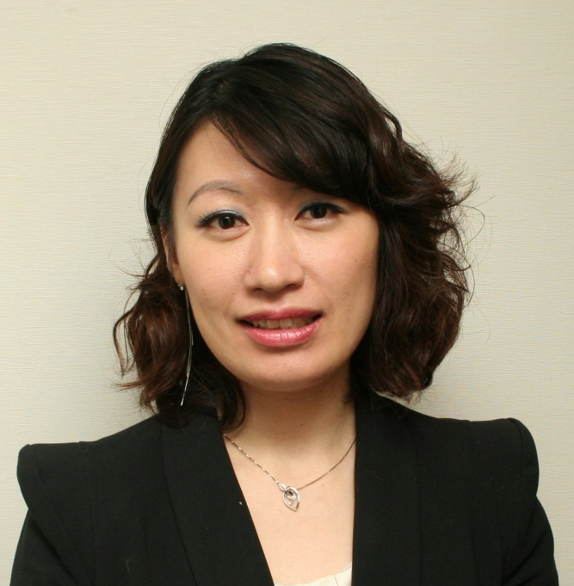
新產品巡禮
New Product Spotlights
Emmy Yeung
產品拓展經理
Product Manager

Slide 2
維他命及膳食補充品在香港的銷售數字
Sales of Vitamins Dietary Supplements in Hong Kong
2013銷售數字
Retail Sales in 2013
複合年均增長率Compound Annual Growth Rate
HK$4,917
↑12.3%
百萬million
2018銷售數字
Retail Sales in 2018
HK$6,666
Source:
Euromonitor International
百萬million
Notes:
http://www.hkexnews.hk/listedco/listconews/SEHK/2014/0930/06893_2055064/E113.pdf

Slide 3
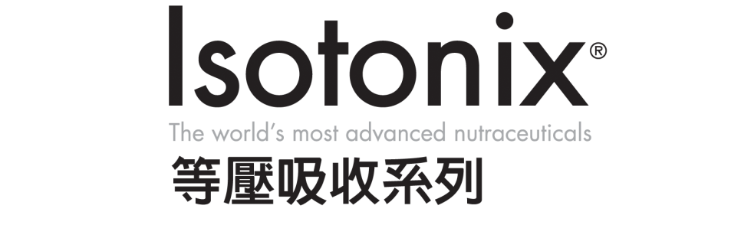


新產品巡禮 New Product Spotlights

Slide 4
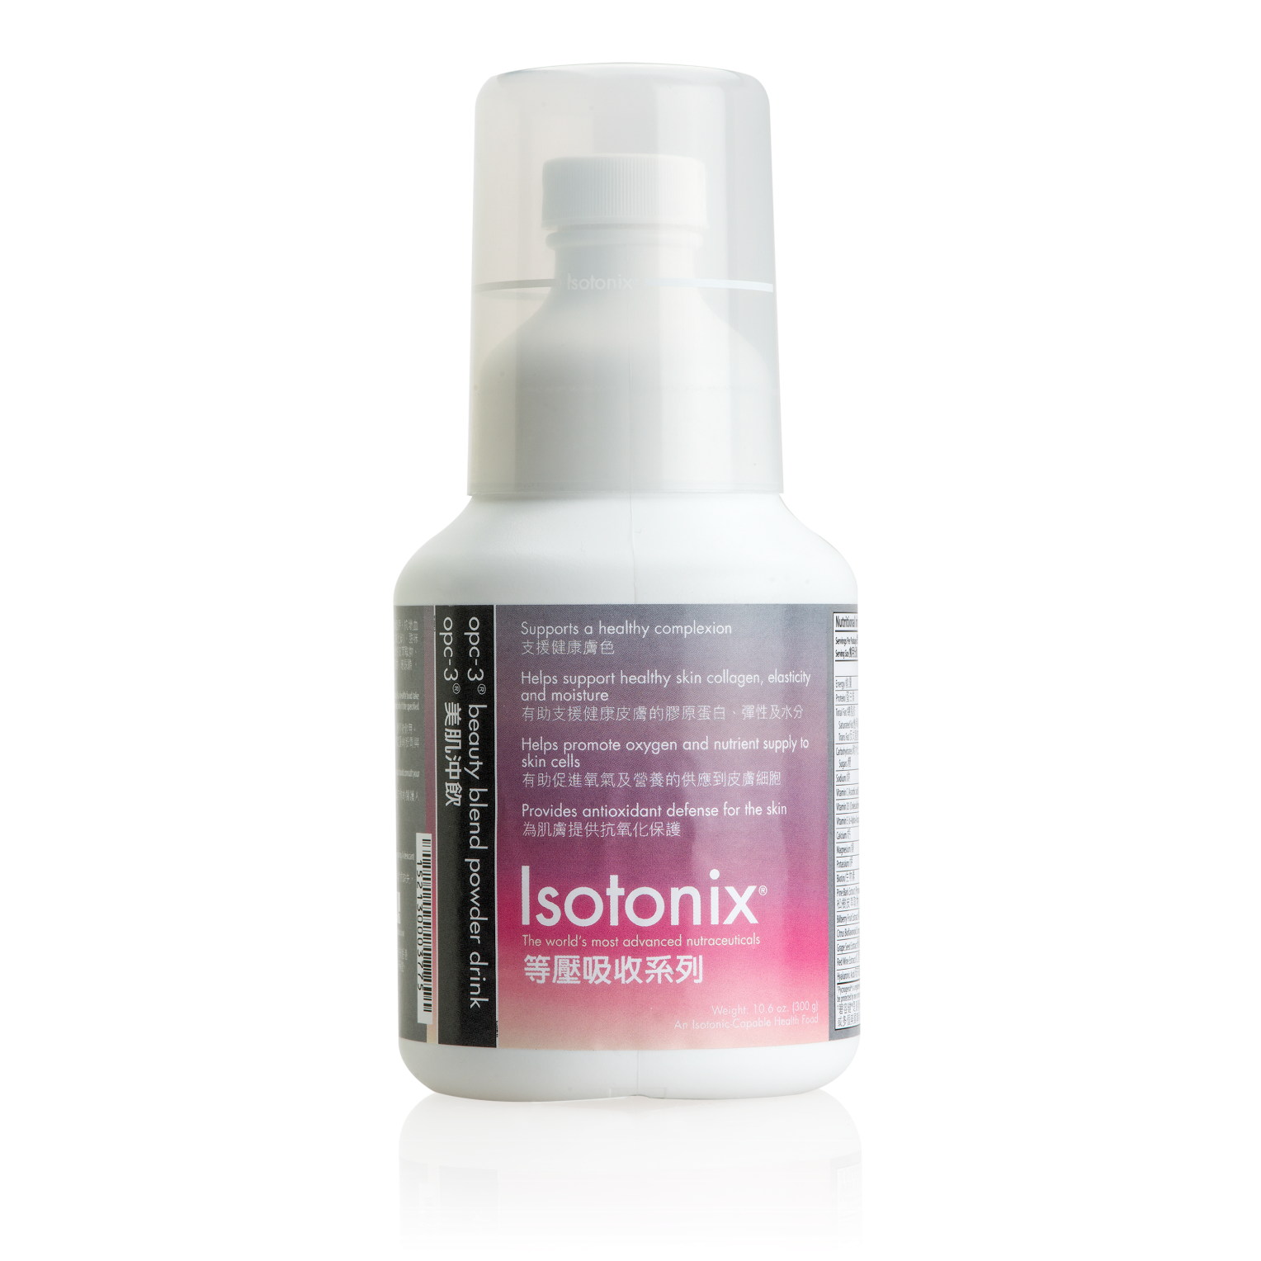
Isotonix®美肌OPC-3®沖飲
OPC-3® Beauty Blend Powder Drink
由內而外的美麗奧秘
Be Beautiful Today and Every Day

Slide 5
Isotonix®美肌OPC-3®沖飲
OPC-3® Beauty Blend Powder Drink
主要成分：
松樹皮萃取物（碧容健®）
葡萄籽萃取物
紅酒萃取物
歐洲藍莓萃取物
柑橘生物類黃酮複合物
玻尿酸（玻尿酸鈉）
Key Ingredients:
Pine Bark Extract (Pycnogenol®)
Grape Seed Extract
Red Wine Extract
Bilberry Extract
Citrus Bioflavonoid Complex
Hyaluronic Acid (Sodium Hyaluronate)
†碧容健®為賀發研究機構 (Horphag Research Ltd.) 的註冊商標，此產品受一個或多個美國專利和其他國際專利的保護。Pycnogenol® is registered trademark of Horphag Research, Ltd. Use of this product may be protected by one or more U.S patents and other international patents.

Slide 6
碧容健®如何由內到外保護皮膚？
How Pycnogenol helps from both inside and out?
Wrinkles
Hyper-pigmentation and brown spots
Suncare
Scar
Scar Formation
減少皺紋
淡化色素沉澱及色斑
防曬
減退疤痕
降低疤痕形成
Source: www.pycnogenol.com

Slide 7
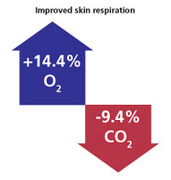
碧容健®提高皮膚中的血液微循環
Pycnogenol enhances blood micro-circulation in the skin
碧容健®增強內皮型一氧化氮（NO）的生成
口服補充碧容健®可改善皮膚的血液循環和氧分壓，並降低二氧化碳濃度。改善皮膚血液循環，保證更適宜地提供各種重要營養物質，以及更加良好的水合作用，維持皮膚活力。
Pycnogenol enhances generation of endothelial nitric oxide (NO)
Taken orally, Pycnogenol was found to increase blood perfusion of the skin and oxygen partial pressure increased and, conversely, carbon dioxide concentration decreased.
Improved blood perfusion warrants optimal supply with all important nutrients, as well as better hydration
Source: www.pycnogenol.com
Notes:
Pycnogenol® enhances generation of endothelial nitric oxide (NO) which is the key mediator facilitating arterial relaxation and consequently allows for optimal blood flow.
Taken orally, Pycnogenol® was found to increase blood perfusion of the skin and oxygen partial pressure increased and, conversely, carbon dioxide concentration decreased. This study demonstrated an improved healing of wounds (ulcers) in individuals with micro-circulatory disorders.
An improved blood perfusion of the skin warrants optimal supply with all important nutrients as well as better hydration to support skin vitality.

Slide 8

碧容健®影響女性皮膚彈性和水合配合增加I型膠原和玻尿酸合成酵素基因
Pycnogenol® effects on skin elasticity and hydration coincide with increased gene expressions of collagen type I and hyaluronic acid synthase in women.
結論：
證實碧容健®營養補充品有助增加人體皮膚水份和彈性，對抗皮膚提前老化。
CONCLUSIONS:
Evidence that Pycnogenol® supplementation benefits human skin by increasing skin hydration and skin elasticity. Pycnogenol® supplementation may thus be useful to counteract the clinical signs of skin aging.
Source: http://www.ncbi.nlm.nih.gov/pubmed/22270036
Notes:
http://www.ncbi.nlm.nih.gov/pubmed/22270036
NTRODUCTION AND OBJECTIVES:
In recent years there has been an increasing interest in the use of nutritional supplements to benefit human skin. Molecular evidence substantiating such effects, however, is scarce. In the present study we investigated whether nutritional supplementation of women with the standardized pine bark extract Pycnogenol® will improve their cosmetic appearance and relate these effects to expression of corresponding molecular markers of their skin.
MATERIALS AND METHODS:
For this purpose 20 healthy postmenopausal women were supplemented with Pycnogenol for 12 weeks. Before, during and after supplementation, their skin condition was assessed (i) by employing non-invasive, biophysical methods including corneometry, cutometry, visioscan and ultrasound analyses and (ii) by taking biopsies and subsequent PCR for gene expression analyses related to extracellular matrix homeostasis.
RESULTS:
Pycnogenol supplementation was well tolerated in all volunteers. Pycnogenol significantly improved hydration and elasticity of skin. These effects were most pronounced in women presenting with dry skin conditions prior to the start of supplementation. The skin-physiological improvement was accompanied by a significant increase in the mRNA expression of hyaluronic acid synthase-1 (HAS-1), an enzyme critically involved in the synthesis of hyaluronic acid, and a noticeable increase in gene expression involved in collagen de novo synthesis.
CONCLUSIONS:
This study provides skin-physiological and for the first time molecular evidence that Pycnogenol supplementation benefits human skin by increasing skin hydration and skin elasticity. These effects are most likely due to an increased synthesis of extracellular matrix molecules such as hyaluronic acid and possibly collagen. Pycnogenol supplementation may thus be useful to counteract the clinical signs of skin aging.

Slide 9
Isotonix美肌OPC-3®沖飲
OPC-3® Beauty Blend Powder Drink
主要好處：
支援健康膚色
有助支援健康肌膚膠原蛋白、彈性和含水量
有助促進肌膚細胞的氧氣和營養供應
為肌膚提供抗氧化防護
支援正常的細胞生長
Primary Benefits:
Supports a healthy complexion
Helps support healthy skin collagen, elasticity and moisture
Helps promote oxygen and nutrient supply to skin cells
Provides antioxidant defense for the skin
Supports normal cell growth
Promotes healthy blood flow to skin cells

Slide 10
Isotonix美肌OPC-3®沖飲
OPC-3® Beauty Blend Powder Drink
現已有售！
Available NOW!
HK13997
UC HK$452.00 | SR HK$633.00
BV 43.5

Slide 11
市埸優勢 VS Competitors
產品 Product | Isotonix® | 碧容健 Pycnogenol® | 玻尿酸 HA | 每食用份量 /價格 Servings/Price
Isotonix美肌OPC-3®沖飲 | √ | √ | √ | 45 / HK$633.00
美國 Puritan’s Pride Pycnogenol® 碧容健® | X | √ | X | 60 / HK$475.00
Catalo金裝水凝亮白美肌專家 | X | X | √ | 30 / HK$398.00
GNC亮髮美肌32 | X | X | X | 30 / HK$498.00

Slide 12
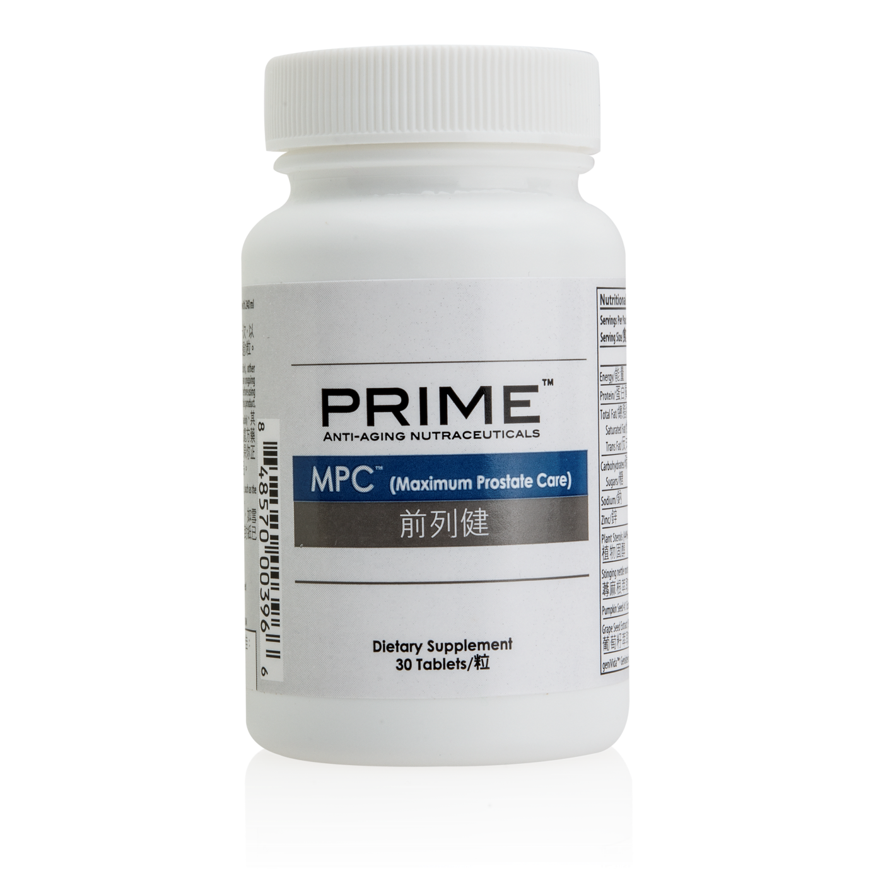
Prime MPC™前列健
MPC™ (Maximum Prostate Care)
結合五種強效草本和兩種精選營養
Combines five potent herbs and two select nutrients

Slide 13

Stephen Ngan
JAS & Associates
保健營養巿場推廣部主管
Head of Healthcare Marketing,
JAS & Associates

Slide 14

前列腺健康和護理
Prostate Health and Care

Slide 15
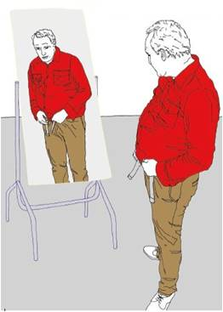
前列腺健康對男士非常重要。前列腺健康對男士整體健康不可或缺，尤其在性功能和生活質素方面。
The prostate gland plays a critical role in men's health. Maintaining prostate health is essential for a man's overall health, especially sexual function and quality of life.

Slide 16
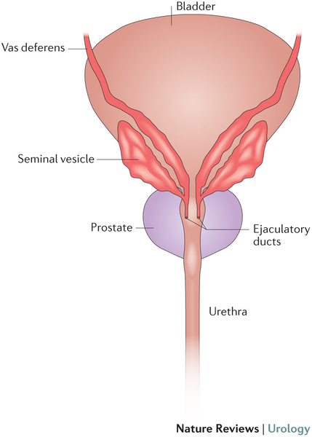
什麼是前列腺？
What is Prostate Gland?
前列腺是男性生殖系統的一部分
它的主要功能是分泌液體滋養精液
The prostate is part of the male reproductive system
Its major function is to secrete a fluid to nourish semen

Slide 17
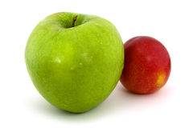
什麼是前列腺？
What is Prostate Gland?
前列腺的大小約核桃，但它可以隨著年齡增大
它位於膀胱下方，在直腸的前面
The prostate is about the size of a walnut but it can grow with age
It is located below the urinary bladder, in front of the rectum.

Slide 18
良性前列腺脹大
Benign Prostatic Hyperplasia BPH
一種非常普遍的退化性疾病
五十歲以上的男性
約有一半開始出現前列腺肥大的情況
而八十歲以上男士接近九成出現前列腺肥大
A very common degenerative disease
About half of all men over age 50 start to develop BPH
Almost 90% of men over age 80 get BPH

Slide 19
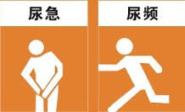
前列腺脹大病徵及病狀
BPH Signs and Symptoms
尿頻
開始排尿時會出現困難，要等一會才能排出小便
尿末滴漏
Frequent urination
Difficulty starting urination or delayed start while trying to urinate
Dribbling at the end of urination

Slide 20
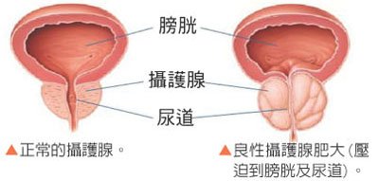
前列腺脹大病徵及病狀
BPH Signs and Symptoms
排尿後，感到尿意未盡，需要用力才能排出
小便失禁
尿中帶血
Feeling that the bladder is not completely emptied after urinating. Straining to urinate
Urge incontinence
Blood in the urine

Slide 21
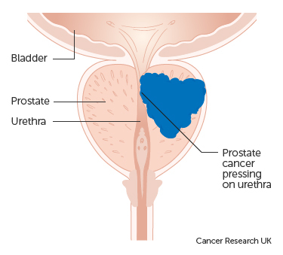
什麼是前列腺癌？
What is Prostate Cancer?
在前列腺開始的惡性腫瘤
有些前列腺癌生長非常緩慢，可能多年不會引起問題
A malignant tumor that begins in the prostate gland
Some prostate cancers grow very slowly and may not cause problems for years

Slide 22
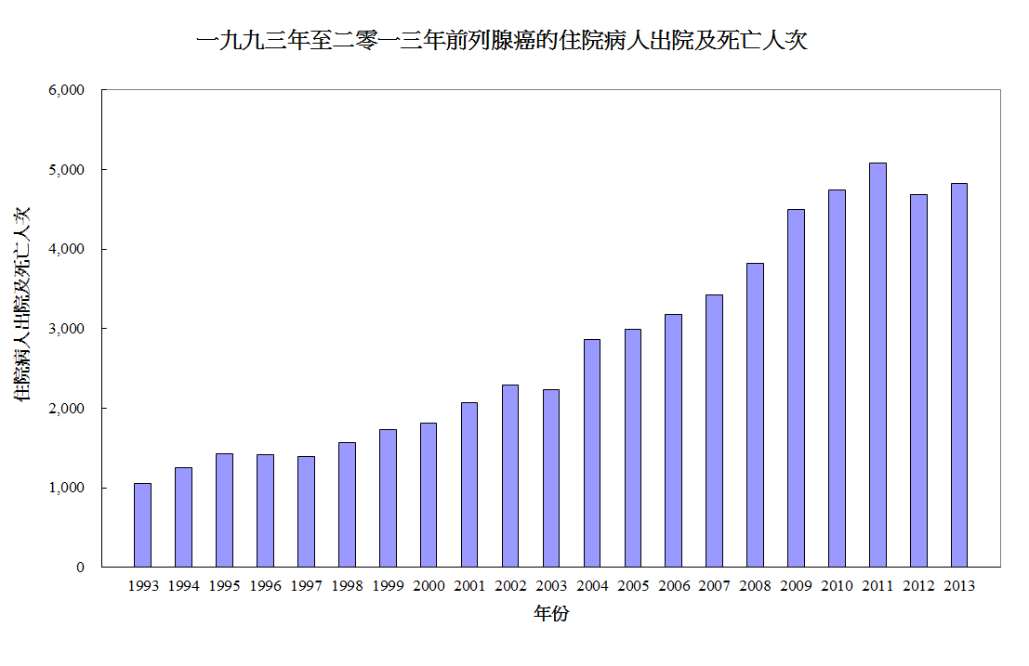
資料來源: 衛生署
Reference: The Department of Health
http://www.healthyhk.gov.hk/phisweb/zh/healthy_facts/disease_burden/major_causes_death/cancers/prostate_cancer/

Slide 23
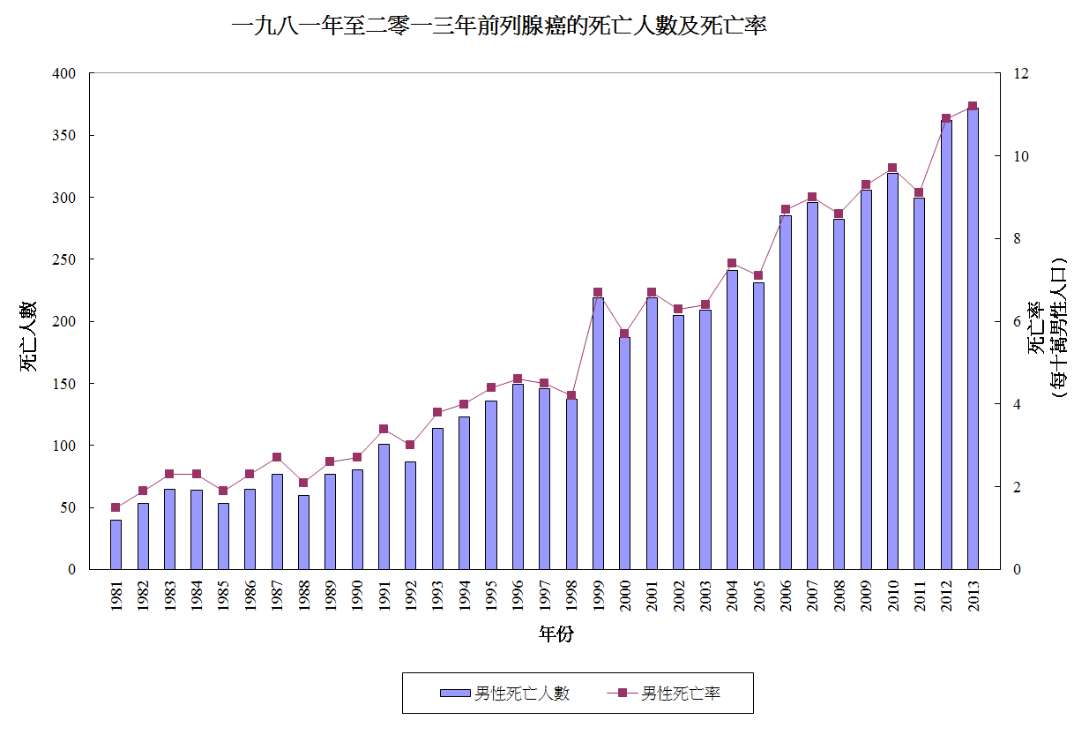
資料來源: 衛生署
Reference: The Department of Health
http://www.healthyhk.gov.hk/phisweb/zh/healthy_facts/disease_burden/major_causes_death/cancers/prostate_cancer/

Slide 24
前列腺癌死亡率：
Prostate Cancer Mortality Rate:
前列腺癌是二零一三年香港男性的第五位致命癌症
在二零一三年，因前列腺癌而死亡的人數為372，佔所有因癌症而死亡的人數為 2.7%
Fifth leading cause of cancer death in male in 2013
In 2013, 372 persons died from prostate cancer, accounting for 2.7% of all cancer deaths

Slide 25
前列腺癌的風險因素：
Prostate Cancer Risk Factors:
年齡
種族
前列腺癌家族史
飲食：
動物飽和脂肪的飲食，罹患前列腺癌的風險可以高一倍。
Age
Race
Family history of prostate cancer
Diet:
A diet high in saturated animal fat can double the risk of
developing prostate cancer

Slide 26
風險因素
Risk Factors
吃紅肉增加患前列腺癌2.64倍風險
紅肉類和乳製品促進前列腺癌的生長和嚴重性
高脂肪飲食降低人體的防禦能力
Eating red meat increases the risk of developing prostate cancer 2.64 times
Red meat and dairy products promote the growth and seriousness of prostate cancer
Eating a diet high in fats also lowers the body’s defenses

Slide 27
飲食建議
Dietary Suggestions
均衡飲食，多吃水果和蔬菜
減少紅肉，加工和油炸食品的攝入
多吃植物類食物，如大豆蛋白
進食可能降低前列腺癌風險的食品
A balanced diet rich in fruits and vegetables
Lower your intake of red meat, processed and fried foods
Eat more plant-based food like soy protein
Eat foods which may be associated with a decreased risk of prostate cancer

Slide 28
飲食建議
Dietary Suggestions
植物固醇
補充植物固醇（尤其是β-谷固醇）有助維持健康的前列腺大小和泌尿功能
Plant Sterols
Supplementing with plant sterols, especially beta sitosterol, helps to maintain a healthy prostate size as well as urinary function.

Slide 29

有研究支持嗎？
Do studies back up the claims?

Slide 30
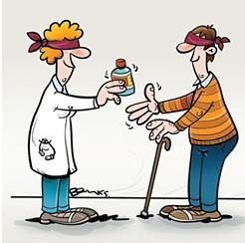
一項雙盲研究…
A Double-Blind Study

Slide 31
β-谷固醇研究
β-sitosterol Study
200 BPH 男病人
  20毫克β-谷固醇 (六個月)
  安慰劑組
200 men with BPH
      20 mg of beta-sitosterol (six months)
      Placebo group
Berges RR, Windeler J, Trampisch HJ, et al. Randomised, placebo-controlled, double-blind clinical trial of beta-sitosterol in patients with benign prostatic hyperplasia. Beta-sitosterol Study Group. Lancet 1995; 345:1529-1532.

Slide 32
β-谷固醇研究結果
β-sitosterol Study Results
結果: β-谷固醇組
增加最大尿流率，並減少平均剩餘尿量
  Results: beta-sitosterol group
  An increase in maximum urine flow rate and a decrease in the mean residual urinary volume
Berges RR, Windeler J, Trampisch HJ, et al. Randomised, placebo-controlled, double-blind clinical trial of beta-sitosterol in patients with benign prostatic hyperplasia. Beta-sitosterol Study Group. Lancet 1995; 345:1529-1532

Slide 33
β-谷固醇研究結論
β-sitosterol Study Conclusions
  紓緩因為前列腺肥大或“良性前列腺增生”（BPH）引起的排尿困難
  服用β-谷固醇有助於紓緩BPH的症狀，它可以結合於前列腺，以幫助紓緩腫脹
    Relieving trouble urinating because of an enlarged prostate, or “benign prostatic hyperplasia” (BPH)
    Taking beta-sitosterol helps the symptoms of BPH and It can also bind to the prostate to help reduce swelling

Slide 34
β-谷固醇研究結論
β-sitosterol Study Conclusions
但它並不收縮前列腺肥大
促進正常的5-甲型還原酵素活動，這種酵素負責將睪丸酮轉化成二氫睪丸酮 (DHT)
  It does not actually shrink an enlarged prostate
  Promotes normal 5-alpha-reductase activity, the enzyme responsible for the conversion of testosterone to dihydrotestosterone (DHT)

Slide 35
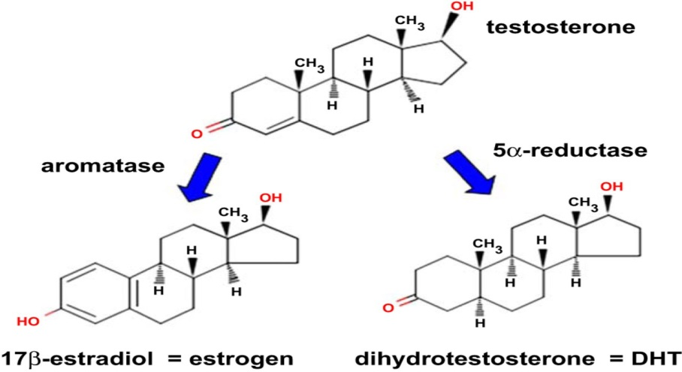
二氫睪丸酮 (DHT)
這種荷爾蒙會影響前列腺健康
  Dihydrotestosterone (DHT)
  Hormone that impacts prostate health

Slide 36
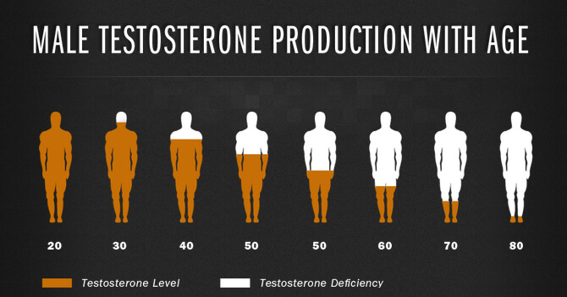

Slide 37
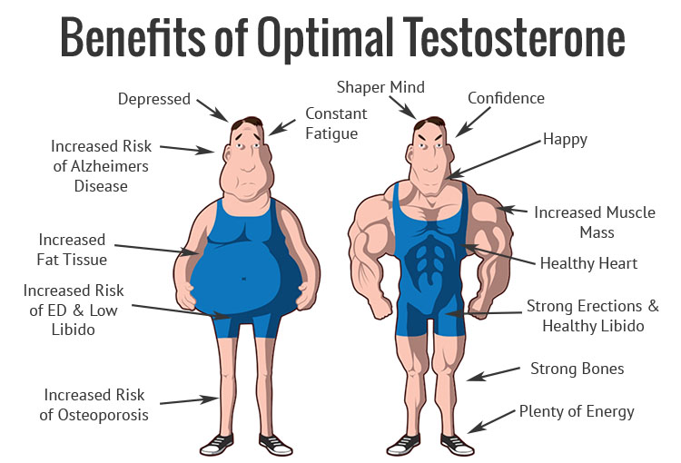
睪丸酮於理想水平的好處

Slide 38
β-谷固醇研究結論
β-sitosterol Study Conclusions
β-谷固醇除可提高前列腺健康，及有其他的健康好處，如有助於降低膽固醇，並對男性禿頭有幫助
Beta-sitosterol can be useful in maximizing your prostate health, plus it has other health benefits as well, such as helping to lower cholesterol and helping with male pattern baldness

Slide 39
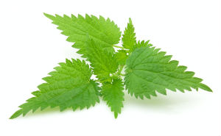
刺蕁麻根萃取物
Stinging Nettle Root Extract
刺蕁麻是多年生草本開花植物，原生於歐洲、亞洲、北非和北美
Stinging nettle or common nettle, Urtica dioica, is an herbaceous perennial flowering plant, native to Europe, Asia, northern Africa and North America

Slide 40
刺蕁麻根萃取物
Stinging Nettle Root Extract
在歐洲廣泛用於治療 “良性前列腺症”
與其它草藥合用，可緩解症狀如低尿流，膀胱排空不全，尿末滴漏和尿頻
Used widely in Europe to treat BPH.
In combination with other herbs, may be effective at relieving symptoms such as reduced urinary flow, incomplete emptying of the bladder, post urination dripping, and the constant urge to urinate

Slide 41
刺蕁麻根萃取物
Stinging Nettle Root Extract
研究表明，刺蕁麻相當於非那雄胺減緩前列腺細胞的生長（常見的處方BPH藥物）。然而，刺蕁麻不會令前列腺縮小
Some studies suggest that stinging nettle is comparable to finasteride (a medication commonly prescribed for BPH) in slowing the growth of certain prostate cells. However, unlike finasteride, the herb does not decrease prostate size

Slide 42
南瓜籽萃取物
Pumpkin Seed Extract
南瓜籽含有豐富蛋白質、類胡蘿蔔素、維他命E和脂肪酸。南瓜籽促進正常尿流和避免膀胱出現不適，從而促進前列腺健康
Pumpkin seed extract is rich in protein, carotenoids, vitamin E, and fatty acids. Pumpkin seed extract aids in prostate health by promoting normal urinary flow and helping to maintain bladder comfort

Slide 43
南瓜籽萃取物研究
Pumpkin Seed Extract Study
30名BPH 病人
  南瓜籽油 (兩個月)
  安慰劑組
30 BPH patients
    Pumpkin Seed Oil (two months)
    Placebo group
Dr Sighi Drassinower, “Pumpkin Seed Oil, a remedy for BPH”, www.drsighi.com/php/showatricles.php?nid=21&type= Nov 2008

Slide 44
南瓜籽萃取物研究結果
Pumpkin Seed Extract Study Results
  66％參與者改善夜間排尿
  86％參與者改善排尿困難症狀
  33％患者前列腺尺寸減小
  There was improvement in night urination in 66% of participants
  86% noted improvement in symptoms of difficulty in urination
  Pumpkin seed oil also showed a decrease in the size of the prostate in 33% of patients

Slide 45
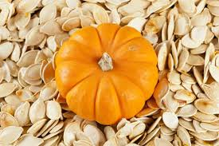
南瓜籽萃取物研究結論
Pumpkin Seed Extract Study Conclusion
南瓜籽中的化學物質會引致排尿增加（利尿作用），這有助於緩解膀胱不適
  The chemicals in the pumpkin seed cause an increase in urination (diuretic effect), which helps relieve bladder discomfort

Slide 46
鋅
Zinc
鋅是存在於人體每個細胞內的重要微量礦物質。鋅的最佳膳食來源包括海鮮、肉類、魚類、家禽和蛋類
  Zinc is an important trace mineral found in every cell of the body. The best dietary sources of zinc are from seafood, meats, fish, poultry and eggs

Slide 47
鋅
Zinc
人體中，前列腺組織累積的鋅比其他任何軟組織都多，而有前列腺問題的男士身體中的鋅含量通常較低
  Within the body, zinc accumulates higher in prostate tissue than in any other soft tissue and those with prostate concerns often test low for zinc

Slide 48

2016美安香港年會
2016 Market Hong Kong Annual Convention

Slide 49
Prime MPC™前列健
MPC™ (Maximum Prostate Care)
結合五種強效草本和兩種精選營養
Combines five potent herbs and two select nutrients
主要成分：
植物固醇
刺蕁麻根萃取物
南瓜籽萃取物
GeniVida™（金雀異黃酮）
葡萄籽萃取物
鋅
Key Ingredients:
Plant Sterols
Stinging Nettle Root Extract
Pumpkin Seed Extract
geniVida™† (Genistein)
Grape Seed Extract
Zinc

Slide 50
Prime MPC™前列健
MPC™ (Maximum Prostate Care)
主要好處：
支援前列健康
支援健康的前列功能
Primary Benefits:
Support prostate health
Supports healthy prostate functions

Slide 51
Prime MPC™前列健
MPC™ (Maximum Prostate Care)
現已有售！
Available NOW!
HK13158
UC HK$287.00 | SR HK$401.00
BV 27.0

Slide 52
市埸優勢 VS Competitors
產品 Product | 植物固醇 Plant Sterols | 刺蕁麻根萃 取物 Stinging Nettle Extract | geniVida™ | 每食用份量 / 價格 Servings / Price
Prime™前列健 | √ | √ | √ | 30 / HK$401.00
Catalo 3083 特強男士前列配方 | X | X | X | 30 / HK$398.00
GNC男士鋸櫚配方 | X | X | X | 60 / HK$339.00
Amway鋸櫚精華 | X | X | X | 33 / HK$443.00

Slide 53


2016 產品專題會 Product Symposium
日期 | 8月27 – 28日（六及日）
地址 | 銅鑼灣 奧運大樓賽馬會演講廳
票價 | HK$1,190
Date | August 27 & 28, 2016 (Saturday and Sunday)
Venue | Jockey Club Lecture Theatre Olympic House
Ticket | HK$1,190
DR. DEEDRA MASON（美國）
美安集團教育與研究總監
陳國賓先生 Leslie Chan
註冊營養師（英國）
Director of Research & Education
REGISTERED DIETITIAN, UK
將有更多來自海外及本地健康營養專家加入…
More oversea and local health professionals will be joining the symposium…

Slide 54

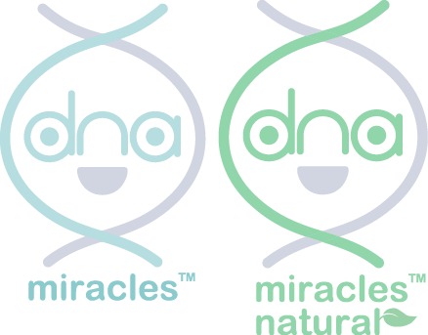
The dna Miracles®

Slide 55


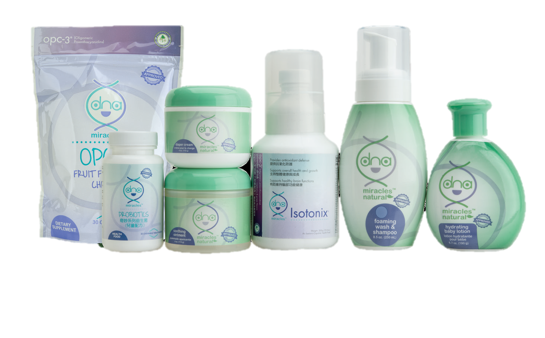

Slide 56
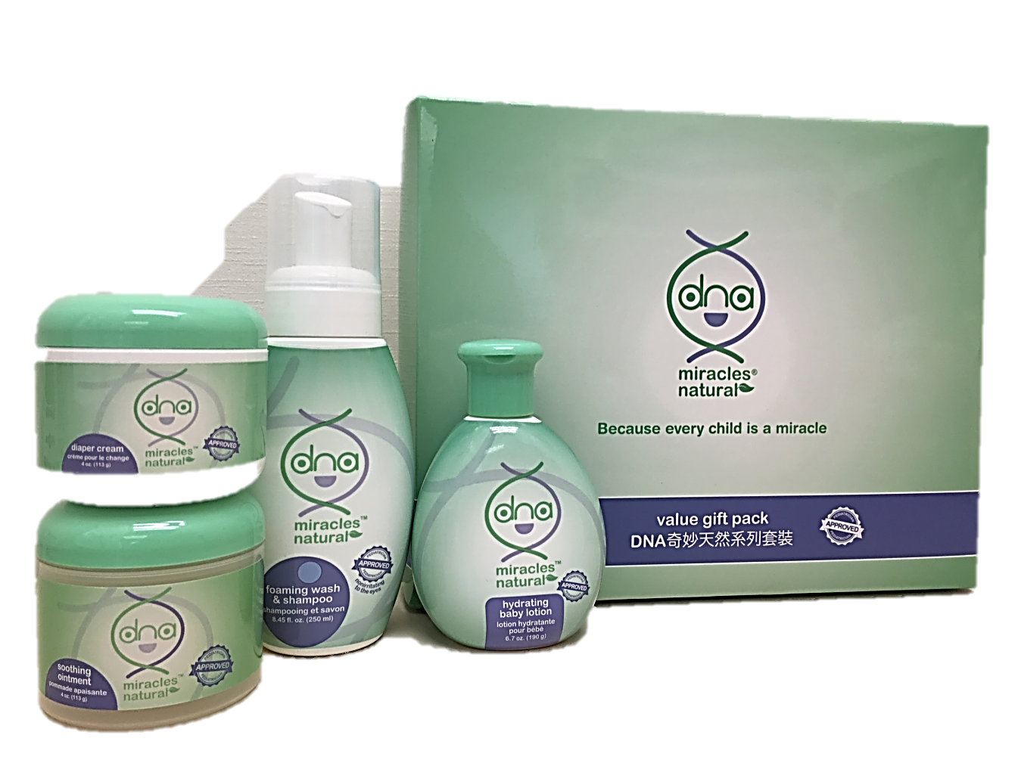
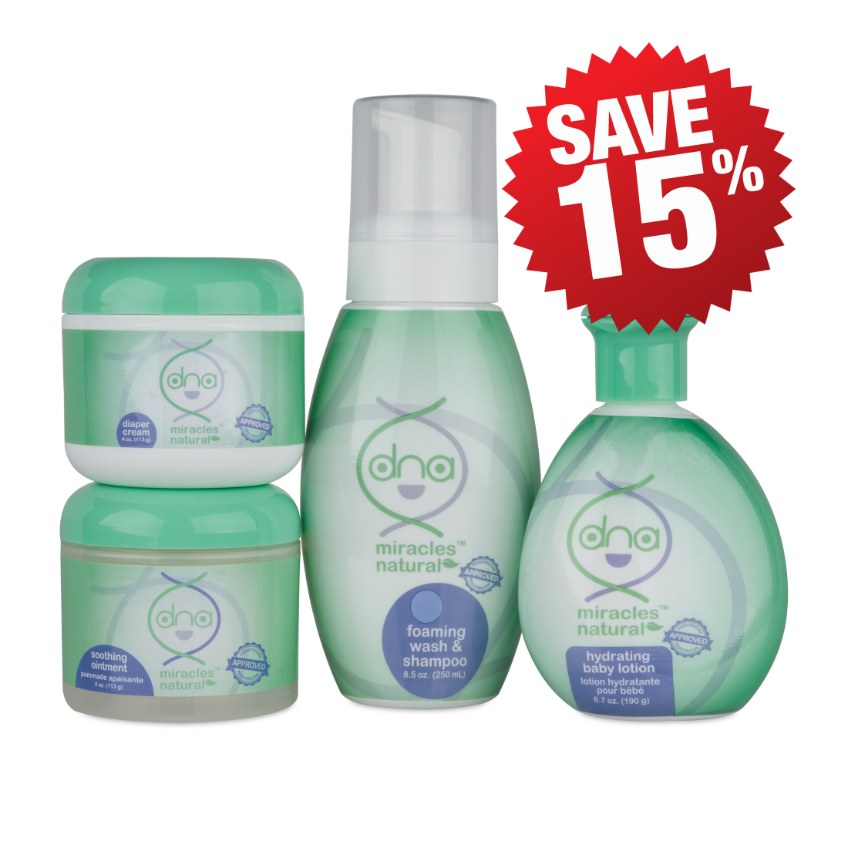
DNA奇妙天然系列套裝
DNA Miracles® Natural Value Kit
15%
HK6934 | UC HK$344.00 | SR HK$480.00 | BV 16.0

Slide 57

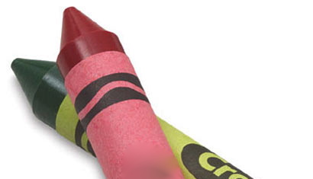
“燦爛開心的將來全賴健康的開始。
- DNA奇妙嬰兒系列
“Brighter days and better tomorrows only exist through healthy beginnings.”
-This is the DNA Way

Slide 58
2016美安香港年會
2016 Market Hong Kong Annual Convention

